Slide 1
Recognizing Opportunities and Generating Ideas
Session 02
Dr Kalpana ambepitiya

Slide 2
Lesson Objectives
Explain why it’s important to start a new firm when its “window of opportunity” is open.
Explain the difference between an opportunity and an idea.
Describe the three general approaches entrepreneurs use to identify opportunities.
Identify the four environmental trends that are most instrumental in creating business opportunities.
List the personal characteristics that make some people better at recognizing business opportunities than others.

Slide 3
Lesson Objectives
Identify the five steps in the creative process.
Describe the purpose of brainstorming and its use as an idea generator.
Describe how to use library and internet research to generate new business ideas.
Explain the purpose of maintaining an idea bank.
Describe three steps for protecting ideas from being lost or stolen.

Slide 4
What is an Opportunity?
An opportunity is a favorable
set of circumstances that
creates a need for a new
product, service or business.
Opportunity Defined

Slide 5
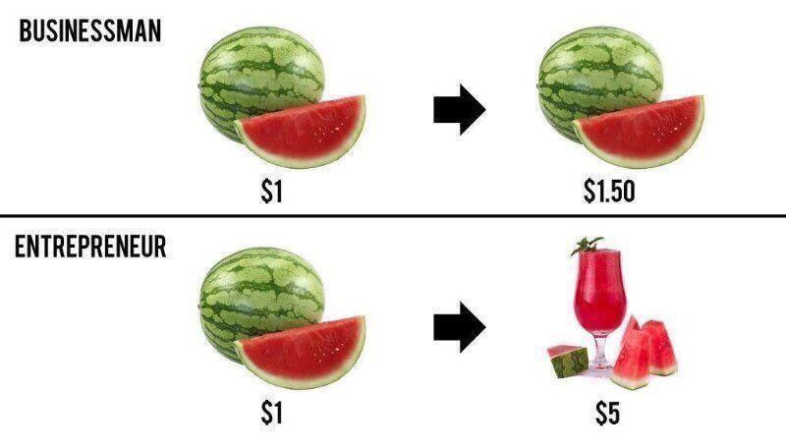
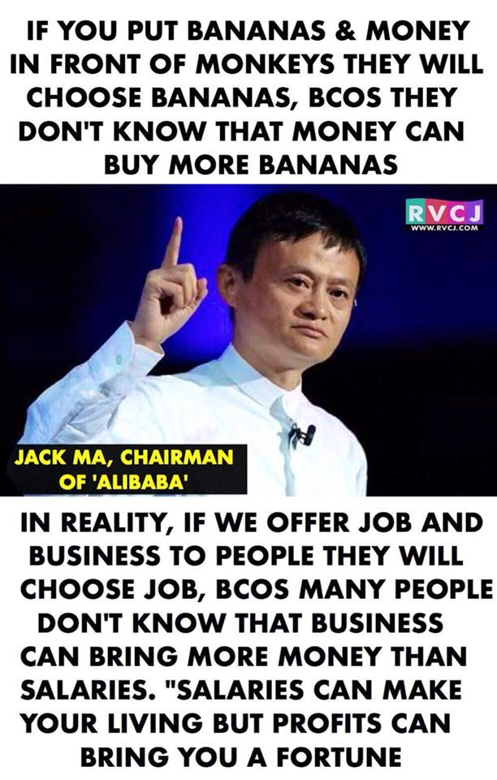

Slide 6
Invention
A new or improved product (material, component, device, machine, system) or process (synthesis, treatment, fabrication, method of manufacturing) discovered as A result of study or experimentation. Inventions that are novel (unique), useful, and non-obvious to someone skilled in the art can be patented as compositions of matter, process of making, or field of use.
Invention is a completely new product or service, a patent, or a breakthrough.

Slide 7
Innovation
The act or process of commercializing an invention or introducing something new or improved that creates value in the form of a commercial product.
Innovation requires people to use new knowledge and understanding to experiment with new possibilities and use sound collaborative decision-making tools to choose and implement new ideas.
Innovation is the turning of all ideas, big and small, into successful outcomes. It's the implementation of ideas generated as a result of the creativity-supporting culture.

Slide 8
Entrepreneurship
Creating the “new” and destroying the “old”,
New knowledge
New products
New processes
New services
New markets
New business models
New raw materials

Slide 9
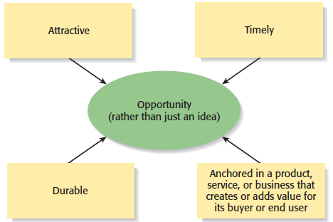
What is an Opportunity?
An opportunity has four essential qualities

Slide 10

Three Ways to Identify an Opportunity

Slide 11
First Approach: Observing Trends
Observing trends
  Trends create opportunities for entrepreneurs to pursue.
  The most important trends are:
    Economic forces
    Social forces
    Technological advances
    Political action and regulatory change
    Natural Environment
  It’s important to be aware of changes in these areas.

Slide 12
PESTEL – Business Environment (External)
P – Political
E – Economical
S – Social
T – Technological
E – Environmental
L – Legal

Slide 13
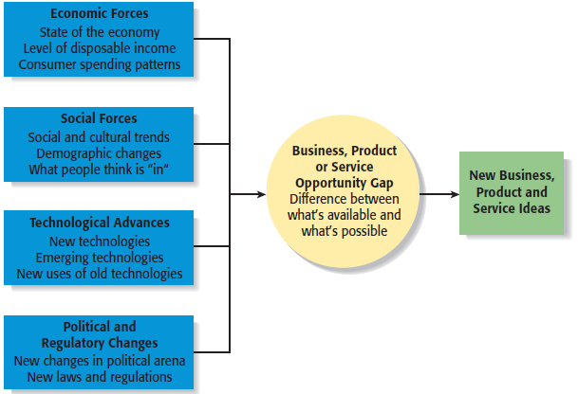
First Approach: Observing Trends
Environmental Trends Suggesting Business or Product Opportunity Gaps

Slide 14
Trend 1: Economic Forces
Example of Economic Trend Creating a Favorable Opportunity
Economic trends help determine areas that are ripe for new startups and areas that startups should avoid.
A weak economy favors
startups that help consumers
save money.
An example is GasBuddy.com,
a company started to help
consumers save money on gas.

Slide 15
Trend 2: Social Forces
Examples of Social Trends
Social trends alter how people and businesses behave and set their priorities. These trends provide opportunities for new businesses to accommodate the changes.
Retirement of baby boomers.
The increasing diversity of
the workplace.
Increasing interest in health,
fitness, and wellness.
Emphasis on alternative forms
of energy.
New forms of music and other
types of entertainment.

Slide 16
Trend 3: Technological Advances
Examples of Entire Industries that Have Been Created as the Results of Technological Advances
Advances in technology frequently create business opportunities.
E-commerce
Streaming and Online Content Industry
Mobile App Development Industry
Electric vehicles

Slide 17
Trend 3: Technological Advances
Example: H2OAudio
Once a technology is created, products often emerge to advance it.
H2OAudio, a company started by four former San Diego State University students, founded in 2003, which creates innovative waterproof audio devices for athletes and water enthusiasts. Their products, including waterproof headphones and MP3 players, feature cutting-edge technology like Bluetooth and bone conduction. Endorsed by athletes like Michael Phelps, H2O Audio ensures high-quality sound underwater, enhancing performance and enjoyment in aquatic activities.

Slide 18
Trend 4: Political Action and Regulatory Changes
Example
The legalization of cannabis in various countries and states. Governments introducing legislation to legalize medical or recreational cannabis trigger the growth of a multibillion-dollar cannabis industry. This change enabled businesses to enter areas like cultivation, distribution, retail, and cannabis-derived products
Political action and regulatory changes also provide the basis for opportunities.

Slide 19
Trend 4: Natural Environmental changes
The eco-tourism is due to the increasing awareness of biodiversity loss and environmental degradation. Natural environmental changes, such as the threat to rainforests, coral reefs, and endangered species, have led to a growing demand for sustainable travel experiences. Eco-tourism promotes conservation efforts while creating opportunities for businesses focused on sustainable hospitality, guided nature tours, and eco-friendly accommodations.
Natural Environmental changes may create many opportunities.

Slide 20
Second Approach: Solving a Problem
Solving a problem
  Sometimes identifying opportunities simply involves noticing a problem and finding a way to solve it.
  These problems can be pinpointed through observing trends and through more simple means, such as intuition or change.

Slide 21
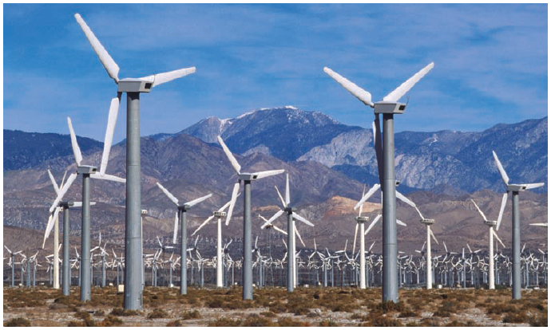
Second Approach: Solving a Problem
A problem facing the U.S. and other countries is finding alternatives to fossil fuels.
A large number of entrepreneurial firms, like this wind farm, are being launched to solve this problem.

Slide 22
Third Approach: Finding Gaps in the Marketplace
Gaps in the marketplace
  A third approach to identifying opportunities is to find a gap in the marketplace
  A gap in the marketplace is often created when a product or service is needed by a specific group of people but doesn’t represent a large enough market to be of interest to mainstream retailers or manufacturers.

Slide 23
Third Approach: Finding Gaps in the Marketplace
In 2000, Tish Ciravolo founded Daisy Rock Girl Guitars to address the lack of guitars designed specifically for women. The company produces electric and acoustic guitars, basses, and ukuleles tailored for female musicians. In 2016, Daisy Rock entered a licensing agreement with KMC Music for global distribution. As of 2024, the company announced plans to relaunch the Heartbreakers series in 2025, with limited models available for purchase through Reverb.com.
Product gaps in the marketplace represent potentially viable business opportunities.

Slide 24
Personal Characteristics of the Entrepreneur
Characteristics that tend to make some people better at recognizing opportunities than others
Prior Experience
Cognitive Factors
Social Networks
Creativity

Slide 25
Prior Experience
Prior industry experience
  Several studies have shown that prior experience in an industry helps an entrepreneur recognize business opportunities.
    By working in an industry, an individual may spot an underserved market niche.
    It is also possible that by working in an industry, an individual builds a network of social contacts who provide insights that lead to recognizing new opportunities.

Slide 26
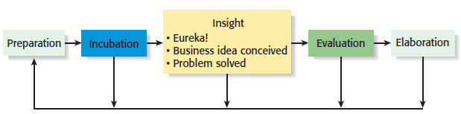
Creativity
Creativity
  Creativity is the process of generating a novel or useful idea.
  Opportunity recognition may be, at least in part, a creative process.
  For an individual, the creative process can be broken down into five stages.
Five-Steps to Generating Creative Ideas

Slide 27
Cognitive Factors
Cognitive factors
  Studies have shown that opportunity recognition may be an innate skill or cognitive process.
  Some people believe that entrepreneurs have a “sixth sense” that allows them to see opportunities that others miss.
  This “sixth sense” is called entrepreneurial alertness, which is formally defined as the ability to notice things without engaging in deliberate search.

Slide 28
Social Networks
Social networks
  The extent and depth of an individual’s social network affect opportunity recognition.
  People who build a substantial network of social and professional contacts will be exposed to more opportunities and ideas than people with sparse networks.
  In one survey of 65 start-ups, half the founders reported that they got their business idea through social contacts.
Strong tie vs. Weak tie relationships
  All of us have relationships with other people that are called “ties.”

Slide 29
Social Networks
Nature of strong-tie vs. Weak tie relationships
  Strong-tie relationships are characterized by frequent interaction and form between coworkers, friends, and spouses.
  Weak-tie relationships are characterized by infrequent interaction and form between casual associations.
Result
  It is more likely that an entrepreneur will get new business ideas through weak-tie rather than strong-tie relationships. (See next slide.)

Slide 30
Social Networks
Why weak-tie relationships lead to more new business ideas than strong-tie relationships
Strong-Tie Relationships
Weak-Tie Relationships
These relationships, which typically form between like minded individuals, tend to reinforce insights and ideas that people already have.
These relationships, which form between casual associations, are not as apt to be between like-minded individuals, so one person may say something to another that sparks a completely new idea.

Slide 31
Full View of the Opportunity Recognition Process
The connection between an awareness of emerging trends and the personal characteristics of the entrepreneur

Slide 32
Techniques For Generating Ideas
Brainstorming
Focus Groups
Library and
Internet Research

Slide 33
Other Techniques
Customer advisory boards
  Some companies set up customer advisory boards that meet regularly to discuss needs, wants, and problems that may lead to new ideas.
Day-in-the-life research
  A type of anthropological research, where the employees of a company spend a day with a customer.
Government support
  National enterprise development authority, small enterprises development, entrepreneurship development – naita,

